Slide 1

Turkiye student evaluation data set
Unsupervised Learning

Slide 2
Problem- Use Clustering Technique to deal with given dataset.
About Dataset- This dataset is based on an evaluation form filled out by students for different courses. It has different attributes including attendance, difficulty, score for each evaluation question, among others. The dataset has 5820 rows and 33 columns.
DATASET
Data Set Characteristics: Multivariate
Number of Attributes: 33
Associated Tasks: Classification, Clustering
Number of features: 28
Number of Patterns: 5820

Slide 3
Description:
instr: Instructor's identifier; values taken from {1,2,3}
class: Course code (descriptor); values taken from {1-13}
repeat: Number of times the student is taking this course; values taken from {0,1,2,3,...}
attendance: Code of the level of attendance; values from {0, 1, 2, 3, 4}
difficulty: Level of difficulty of the course as perceived by the student; values taken from {1,2,3,4,5}
Q1: The semester course content, teaching method and evaluation system were provided at the start.
Q2: The course aims and objectives were clearly stated at the beginning of the period.
Q3: The course was worth the amount of credit assigned to it.
Q4: The course was taught according to the syllabus announced on the first day of class.
Q5: The class discussions, homework assignments, applications and studies were satisfactory.
Q6: The textbook and other courses resources were sufficient and up to date.
Q7: The course allowed field work, applications, laboratory, discussion and other studies.
Q8: The quizzes, assignments, projects and exams contributed to helping the learning.
Q9: I greatly enjoyed the class and was eager to actively participate during the lectures.
Q10: My initial expectations about the course were met at the end of the period or year.
Q11: The course was relevant and beneficial to my professional development.
Q12: The course helped me look at life and the world with a new perspective.
Q13: The Instructor's knowledge was relevant and up to date.
Q14: The Instructor came prepared for classes.
Q15: The Instructor taught in accordance with the announced lesson plan.
Q16: The Instructor was committed to the course and was understandable.

Slide 4
Q17: The Instructor arrived on time for classes.
Q18: The Instructor has a smooth and easy to follow delivery/speech.
Q19: The Instructor made effective use of class hours.
Q20: The Instructor explained the course and was eager to be helpful to students.
Q21: The Instructor demonstrated a positive approach to students.
Q22: The Instructor was open and respectful of the views of students about the course.
Q23: The Instructor encouraged participation in the course.
Q24: The Instructor gave relevant homework assignments/projects, and helped/guided students.
Q25: The Instructor responded to questions about the course inside and outside of the course.
Q26: The Instructor's evaluation system (midterm and final questions, projects, assignments, etc.) effectively measured the course objectives.
Q27: The Instructor provided solutions to exams and discussed them with students.
Q28: The Instructor treated all students in a right and objective manner.
Q1-Q28 are all Likert-type, meaning that the values are taken from {1,2,3,4,5}

Slide 5
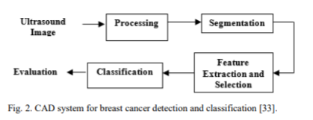
Literature Survey:
Paper-1: Region of Interest Segmentation Based on ClusteringTechniques for Breast Cancer Ultrasound Images
The most prevalent cancer amongst women is woman breast cancer. Ultrasound imaging is a widely employed method for identifying and diagnosing breast abnormalities. Computer-aided diagnosis technologies have lately been developed with ultrasound images to help radiologists enhance the accuracy of the diagnosis. This paper presents several ultrasound image segmentation techniques, mainly focus on eight clustering methods over the last 10 years, and it shows the advantages and disadvantages of these approaches. Breast ultrasound image segmentation is, therefore, still an accessible and challenging issue due to numerous ultrasound artifacts introduced in the imaging process, including high speckle noise, poor contrast, blurry edges, weak signal-to-noise ratio, and intensity inhomogeneity.

Slide 6
Paper-2: Adaptive Apriori Algorithm for frequent itemset mining
Obtaining frequent itemsets from the dataset is one of the most promising area of data mining. The Apriori algorithm is one of the most important algorithm for obtaining frequent itemset from the dataset. But the algorithm fails in terms of time required as well as number of database scans. Hence a new improved version of Apriori is proposed in this paper which is efficient in terms of time required as well as number of database scans than the Apriori algorithm. We presented experimental results, showing that the proposed algorithm always outperform Apriori. To evaluate the performance of the proposed algorithm, we have tested it on Turkey student's database as well as a real time dataset.
Paper-2: A hierarchical clustering method: Applications to educational data
In this paper we have proposed a new procedure to induce probabilistic graphical models with hidden variables from data: a hierarchical clustering. Instead of considering only one hidden variable as in AutoClass, we consider a tree of hidden variables. Experiments have shown that this model have good performance for estimating a joint probability distribution from a dataset of observations, but it has some additional advantages against general learning procedures of Bayesian networks: it produces trees (or forest trees) that are simple to interpret and fast for computing.

Slide 7
Paper-4: Research on social data by means of cluster analysis
This paper presents a data mining study and cluster analysis of social data obtained on small producers and family farmers from six country cities in Ceará state, northeast Brazil. The analyzed data involve demographic, economic, agriculture and food insecurity information. The goal of the study is to establish profiles for the small producer families that reside in the region and to identify relevant features which differentiate these profiles. Moreover, we provide an efficient data mining methodology for analysis of social data sets which is capable of handling its natural challenges, such as mixed variables and abundance of null values. We use the Silhouette method for the estimation of the best number of natural groups within the data, along with the Partitioning Around Medoids clustering algorithm in order to compute the profiles. The Correlation-Based Feature Selection method is used to identify which social criteria are the most important to differentiate the families from each profile. Classification models based on support vector machines, multilayer perceptron and decision trees were developed aiming to predict in which of the identified clusters an arbitrary family would be best fit. We obtained a good separation of the families into two clusters, and a multilayer perceptron model with approximately 93.5% prediction accuracy.

Slide 8
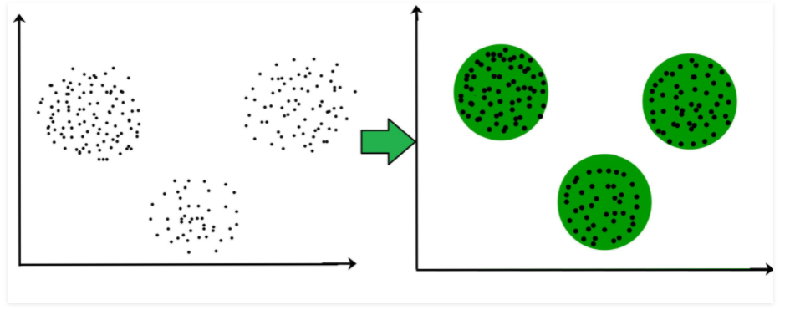
Clustering(Unsupervised Learning)
Clustering is the task of dividing the population or data points into a number of groups such that data points in the same groups are more similar to other data points in the same group and dissimilar to the data points in other groups(high intra-cluster similarity and low inter-cluster similarity). It is basically a collection of objects on the basis of similarity and dissimilarity between them.
ML models used to analyse the dataset:
K-Means
K-Medoids
Fuzzy C-Mean
Self Optimizing Maps

Slide 9
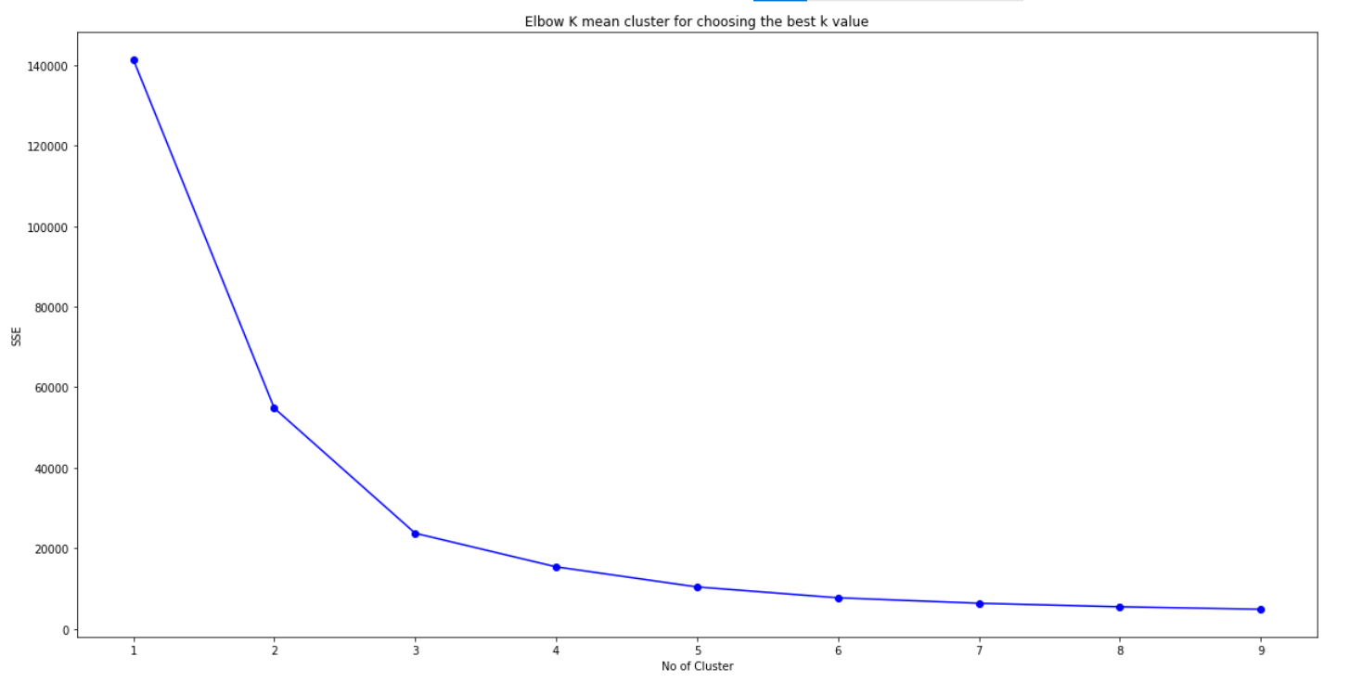
K-Means Algorithm
To get an optimal k value we use the elbow method.
So from the elbow method we are choosing 4 as the number of cluster centers.
K MEAN: SSE: 15359.195818906082
K MEAN: Silhouette Score for 4 cluster centers: 0.6014247641313798
K-MEAN: Cluster Center:
[[ 1.07431623 -0.18951523]
[-7.09699703 0.32460977]
[ 7.36680187 0.24979591]
[-3.0066185 -0.10830166]]

Slide 10

K-medoids algorithm(Partition around medoids (PAM)
The k-Medoids algorithm aims to diminish the effect of outliers. Medoids are similar in concept to means or centroids, but medoids are always restricted to be members of the data set.
k-Medoids: SSE: 8588.758908930922
k-Medoids: Silhouette Score: 0.49963123320843233
k-Medoids: Cluster Medoids:
[[ 0.78287487 0.4050173 ] [-3.35946227 0.45324548]
[-1.20214038 -1.70372215] [ 9.06754915 0.30856096]]
From the result we can see that k mean is performing better than k medoid as the Silhouette score for k-mean is greater than k-medoid. Here we can assume that the dataset is outlier sensitive.

Slide 11
Fuzzy C-Mean clustering algorithm
Fuzzy clustering is a powerful unsupervised method for the analysis of data and construction of models. The FCM employs fuzzy partitioning such that a data point can belong to all groups with different membership grades between 0 and 1(Each pattern belongs to simultaneously more than one cluster with a membership value).
Different Values of SSE and Silhouette Score for different degree of fuzziness:
m(degree of fuzziness) | SSE(Sum Squared Error) | Silhouette score
1.34 | 18352.224482800455 | 0.562349864832
1.4 | 18358.723086909213 | 0.562349864832
1.5 | 18376.27653934582 | 0.562468155403
1.6 | 15560.424679981536 | 0.599478247266
1.7 | 18443.46041452291 | 0.562499479948
1.8 | 15825.310021260626 | 0.597427539915
1.9 | 18562.997082058482 | 0.561708517331
2.0 | 16137.767467845688 | 16137.76746784

Slide 12
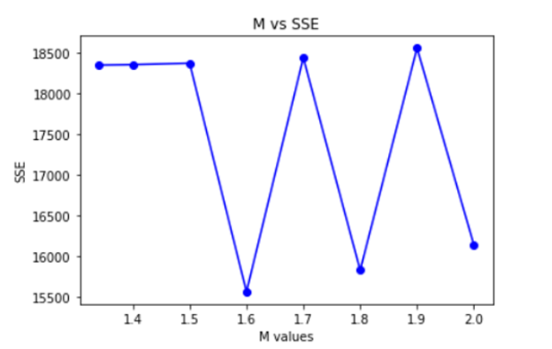
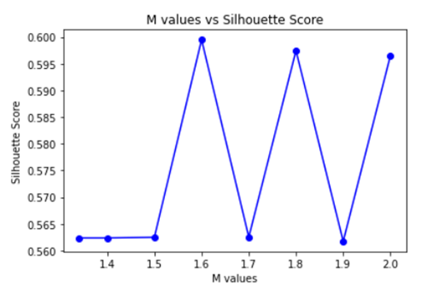
From those two plots we can see that at 1.6 (m = 1.6) we are getting min SSE and maximum Silhouette Score. So we are taking m(degree of fuzziness) = 1.6
FCM: The SSE: 18376.27653934582
FCM: Silhouette Score 0.5624681554036455
FCM: Cluster Center:
[[-4.88275521 0.1990048 ]
[ 0.37298547 -0.13696873]
[ 4.29397991 -0.22229233]
[ 8.78659518 0.36103488]]

Slide 13
Self-Organizing Maps (SOM)
A self-organizing map (SOM) is an unsupervised machine learning technique used to produce a low-dimensional (typically two-dimensional) representation of a higher dimensional data set while preserving the topological structure of the data.
SOM: The SSE: 24616.1278244987
SOM: Silhouette Score 0.5488398550158445
SOM: Cluster Center:
[[[-4.83931207 -0.1297401 ]]
[[-2.23867633 -0.39316262]]
[[ 1.5298642 -0.0780462 ]]
[[ 5.42947561 0.12885104]]]

Slide 14
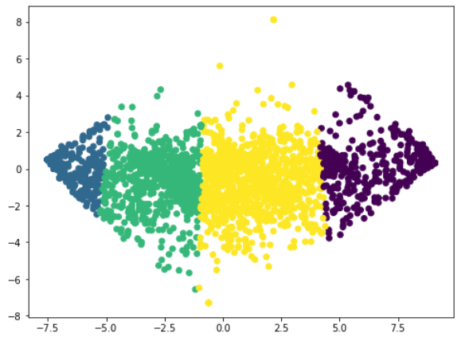
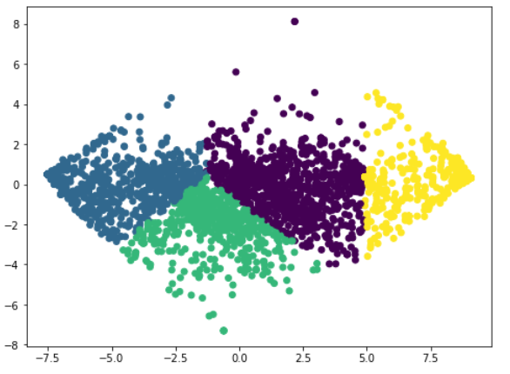
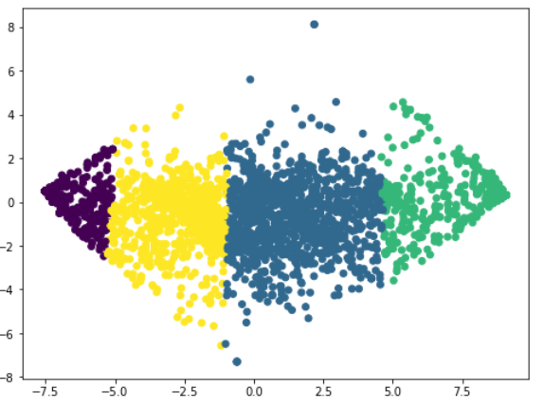
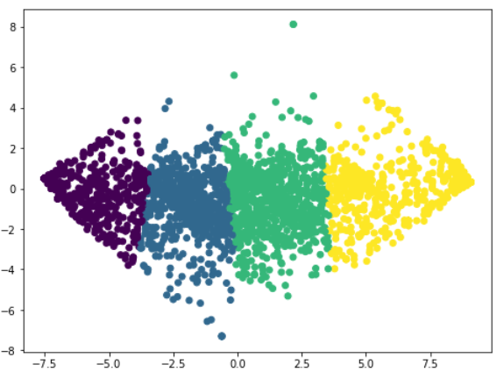
Overview of all the four algorithms cluster-wise
K-Means
K-Medoids
Fuzzy C-Mean
Self Optimizing Maps

Slide 15
Principal Component Analysis(PCA) [Novelty]
Principal Component Analysis, or PCA, is a dimensionality-reduction method that is often used to reduce the dimensionality of large data sets, by transforming a large set of variables into a smaller one that still contains most of the information in the large set.
Reducing the number of variables of a data set naturally comes at the expense of accuracy, but the trick in dimensionality reduction is to trade a little accuracy for simplicity. Because smaller data sets are easier to explore and visualize and make analyzing data much easier and faster for machine learning algorithms without extraneous variables to process.
So to sum up, the idea of PCA is simple — reduce the number of variables of a data set, while preserving as much information as possible.

